Slide 1



CAR -PRICE PREDICTION PROJECT
Durgadhar Pathak
Internship 15

Slide 2
The first step is to establish that something is possible. Then probability will occur..
- Elon musk

Slide 3
Problem Statement
With the covid 19 impact in the market, we have seen lot of changes in the car market. Now some cars are in demand hence making them costly and some are not in demand hence cheaper. One of our clients works with small traders, who sell used cars. With the change in market due to covid 19 impact, our client is facing problems with their previous car price valuation machine learning models. So, they are looking for new machine learning models from new data. We have to make car price valuation model. This project contains two phase-
1- Data Collection Phase: -
We have to scrape at least 5000 used cars data. We can scrape more data as well, it’s up to us. more the data better the model. In this section we need to scrape the data of used cars from websites (car Dekho, Cars24 etc.) We need web scraping for this. We have to fetch data for different locations. The number of columns for data doesn’t have limit, it’s up to us and our creativity. Generally, these columns are Brand, model, variant, manufacturing year, driven kilometres, fuel, number of owners, location and at last target variable Price of the car. This data is to give us a hint about important variables in used car model. We can make changes to it, we can add or we can remove some columns, it completely depends on the website from which we are fetching the data. We will try to include all types of cars in our data for example- SUV, Sedans, Coupe, minivan, Hatchback.
2- Model Building Phase: -
After collecting the data, we need to build a machine learning model. Before model building do all data pre-processing steps. Try different models with different hyper parameters and select the best model.

Slide 4
Motivation & Understanding
Motivation:- Deciding whether a used car is worth the posted price when we see listings online can be difficult. Several factors including Brand, Model, Variant, Body type, Fuel, Number of Owners, Driven Kilometres, mileage and Manufacturing year can influence actual worth of car. From perspective of a seller, it is also a dilemma to price a used car appropriately. Based on existing data sources, our aim is to use machine learning algorithms to develop models for predicting used car prices.
Business Goal:-
First we need to collect used car data from different websites using web scraping techniques & then need to build a machine learning model.
Target Variable:- Target Variable is Price in this project & it is continuous in nature so we will use Regression algorithms to make our model.
Follow the complete life cycle of data science. Include all the steps like.
Data Cleaning
Exploratory Data Analysis
Data Pre-processing
Model Building
Model Evaluation
Selecting the best model

Slide 5
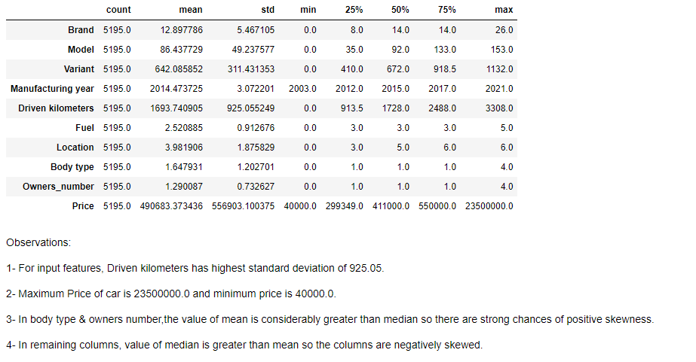
Statistical Summary

Slide 6
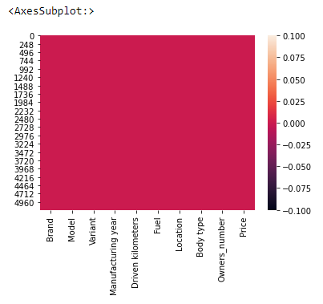
Missing Data
Missing Data: - Missing data are values that are not recorded in a dataset. They can be a single value missing in a single cell or missing of an entire observation. Missing data can occur both in a continuous variable or categorical variable. We had checked missing values in our dataset & dataset has no missing values.

Slide 7
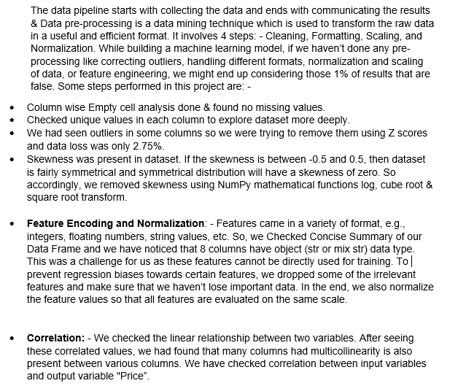
Data Pre-Processing

Slide 8
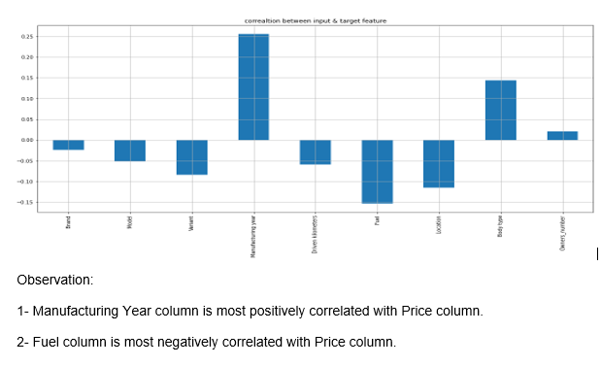
Correlation
Correlation is a statistical measure of how two securities move in relation to each other. We checked the linear relationship between two variables. After seeing these correlated values, we had found that many columns had multicollinearity is also present between various columns. We have checked correlation between input variables and output variable “Price”: -

Slide 9
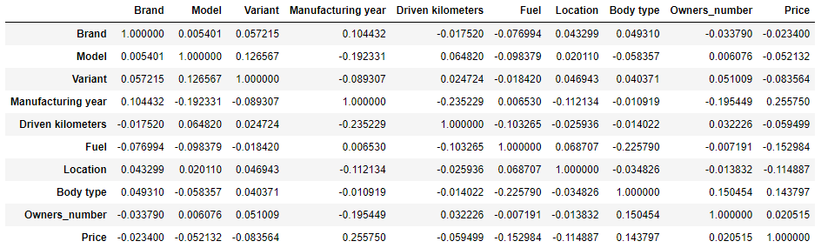
Correlation Matrix
A correlation matrix is a table showing correlation coefficients between variables. Each cell in the table shows the correlation between two variables. A correlation matrix is used to summarize data, as an input into a more advanced analysis, and as a diagnostic for advanced analyses. It consists of rows and columns that show the variables.

Slide 10
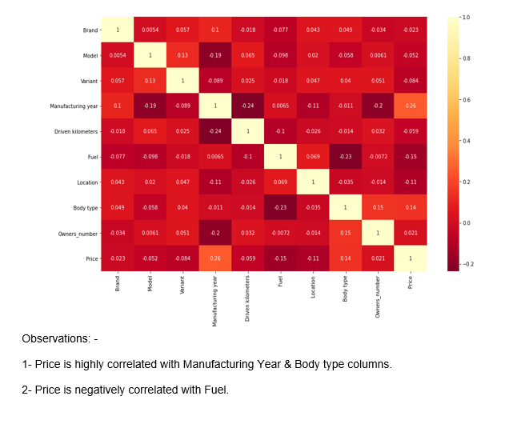
Correlation Matrix using Heatmap

Slide 11
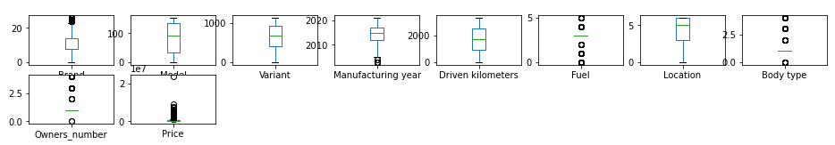
Plotting Outliers
An outlier is an observation that lies an abnormal distance from other values in a random sample from a population. Outliers should be investigated carefully. So, we will use graphical techniques Box Plot for identifying outliers.
Univariate Analysis: - Univariate involves the analysis of a single variable. First, we are going to do univariate analysis using Box Plot method.
Observation: Outliers are present in various columns.

Slide 12
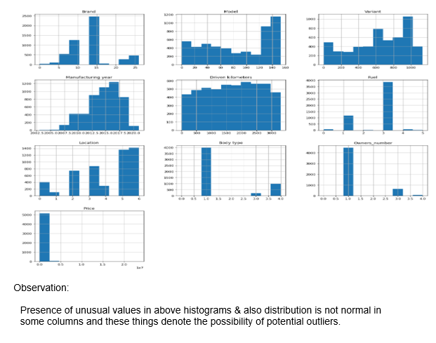
Histogram
Histogram: - we are creating histograms to get broader idea of the distribution.

Slide 13
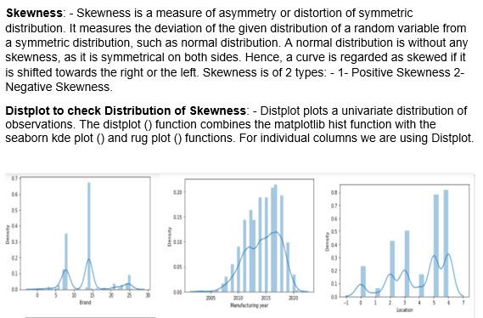
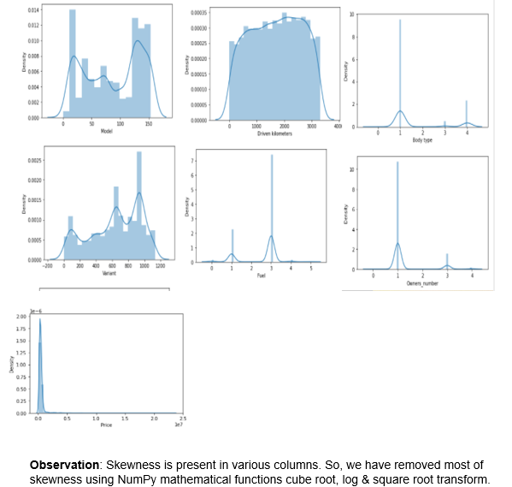
Skewness

Slide 14
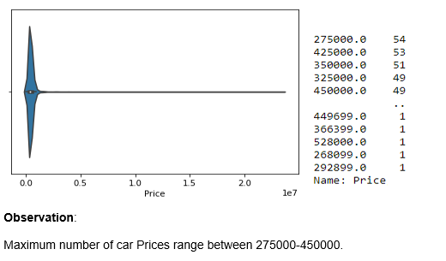
Data Visualizations
Data visualization is the graphical representation of information and data. We have checked visualizations for our input and output features in our dataset.
Exploring Output Feature: - Violin plot for our target variable & value counts are as: -

Slide 15
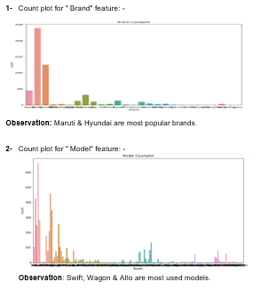
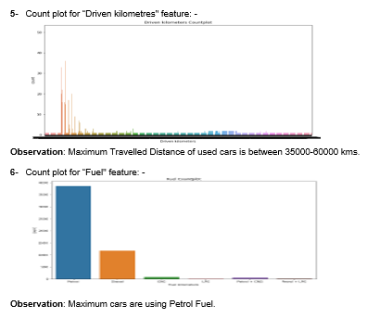
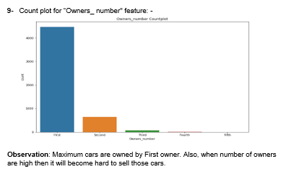
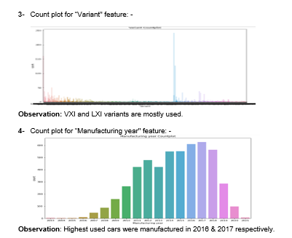
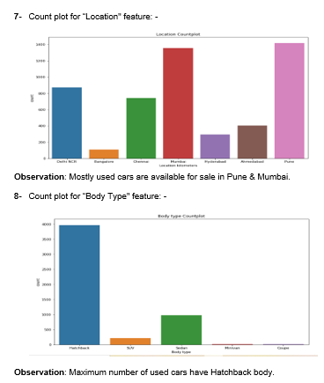
Exploring Input Features: Count Plot

Slide 16
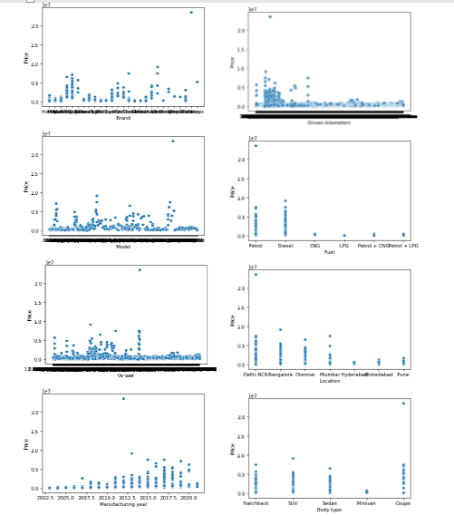
Bivariate analysis
Bivariate Analysis: - It involves the analysis of two variables, for the purpose of determining the empirical relationship between them. We are using scatterplot for this purpose.
Scatter Plot- Scatter plot reveals relationships or association between two variables. Scatter Plot between Output and Input Features: -

Slide 17
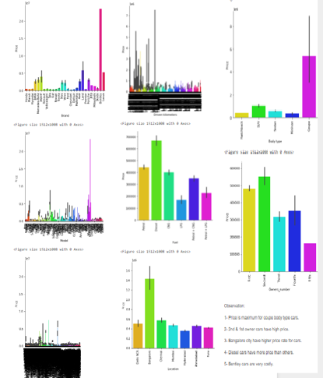
Cat Plot (Categorical Type features)

Slide 18
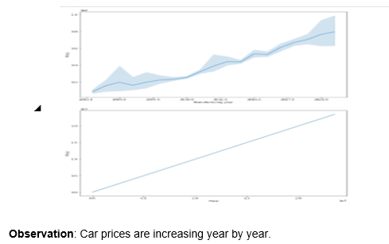
Line Plot (Continuous Type features)

Slide 19
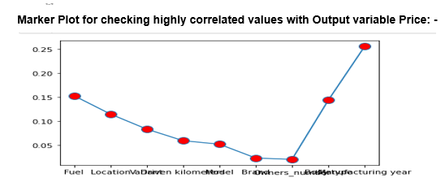
Marker Plot

Slide 20
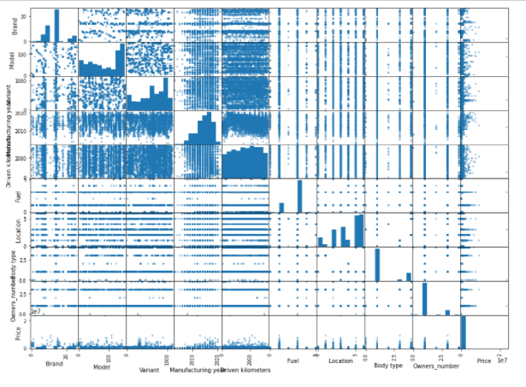
Multivariate Analysis
Multivariate Analysis: - Multivariate analysis is used to study more complex sets of data. It is a statistical method that measures relationships between two or more response variables.
Scatter plot matrix: -Scatter plot matrix is a grid (or matrix) of scatter plots used to visualize bivariate relationships between combinations of variables.
Observation: Using multivariate analysis, we can look at interactions between variables. Scatter plots of all pair of attributes helps us to spot structured relationship between input variables.

Slide 21
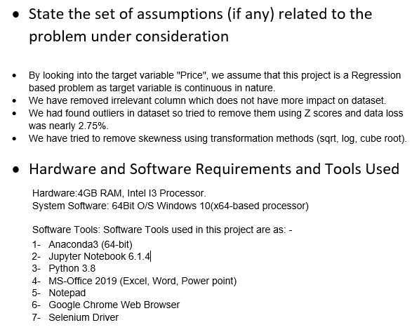
Assumptions & Tools used

Slide 22
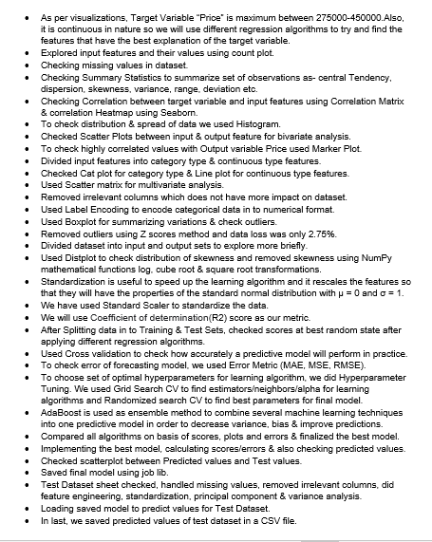
Steps used in this Project

Slide 23
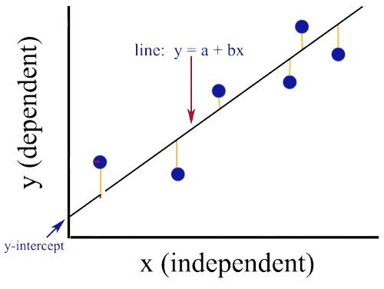
Regression in Machine Learning
Regression in machine learning consists of mathematical methods that allow data scientists to predict a continuous outcome (y) based on the value of one or more predictor variables (x). Linear regression is probably the most popular form of regression analysis because of its ease-of-use in predicting and forecasting. It predicts continuous/real values such as temperature, age, salary, price, etc. Regression is a supervised learning technique which helps in finding the correlation between variables and enables us to predict the continuous output variable based on the one or more predictor variables. In Regression, we plot a graph between the variables which best fits the given datapoints, using this plot, the machine learning model can make predictions about the data. Target variable is continuous in nature so we are using regression algorithms.

Slide 24
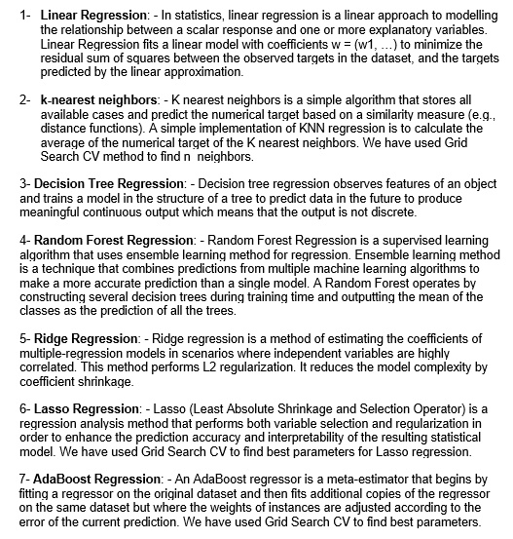
Regression Algorithms used

Slide 25
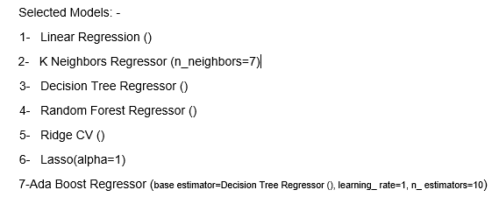
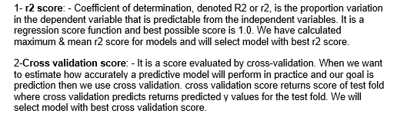
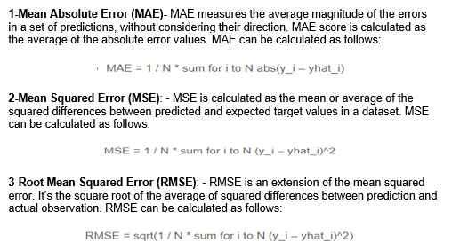
Model selection & Evaluation
Selected Models: -
Evaluation Metrics:-
Error Metrics:-

Slide 26
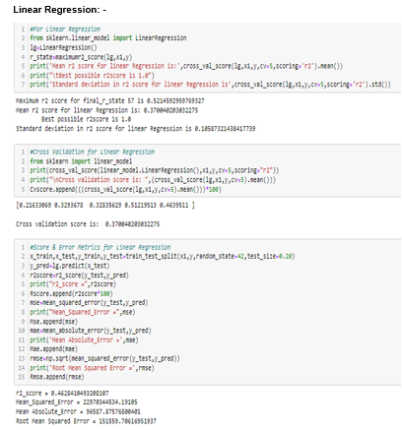
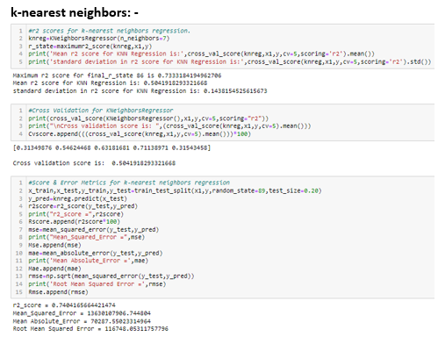
Regression Algorithms

Slide 27
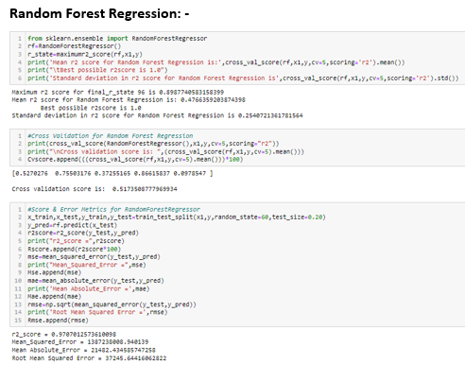
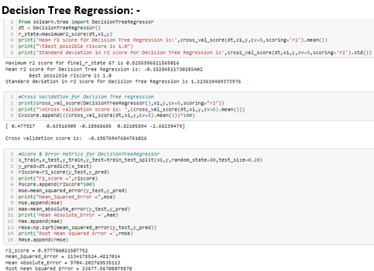
Regression Algorithms

Slide 28
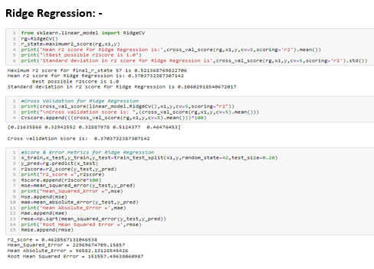
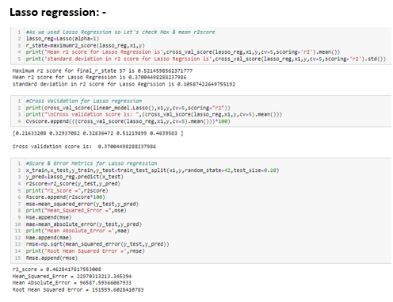
Regression Algorithms

Slide 29
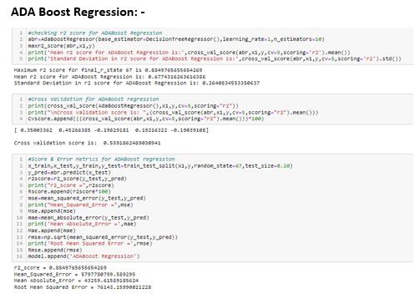
Regression using Ensemble methods

Slide 30
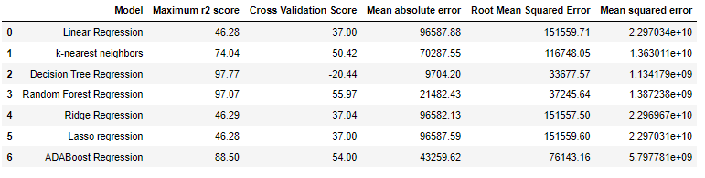
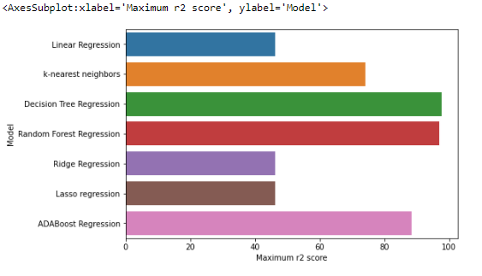
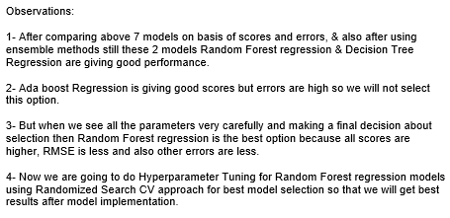
Model Dashboard & Bar Plot

Slide 31
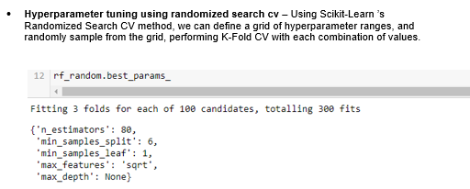
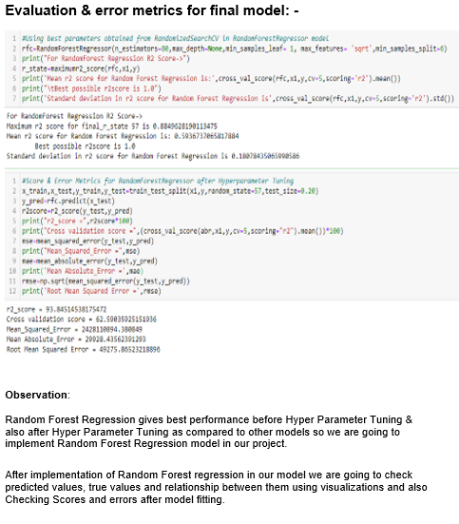
Interpretation of the Results

Slide 32
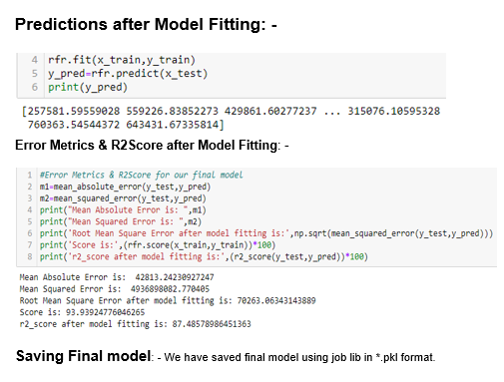
Error Metrics & R2Score after Model Fitting: -

Slide 33
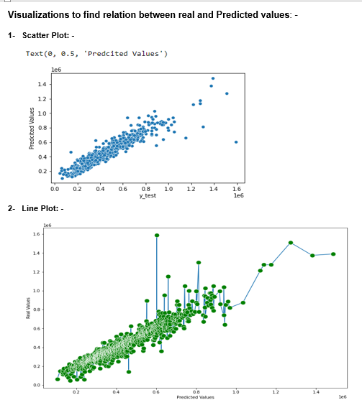
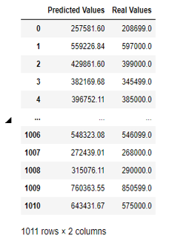
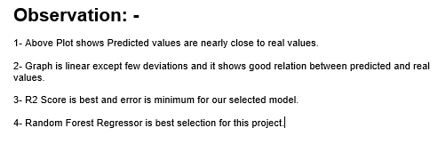
Evaluate Predictions

Slide 34
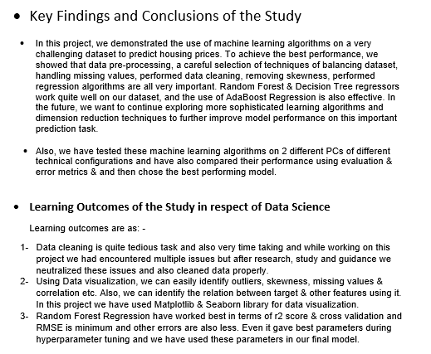
Conclusion

Slide 35
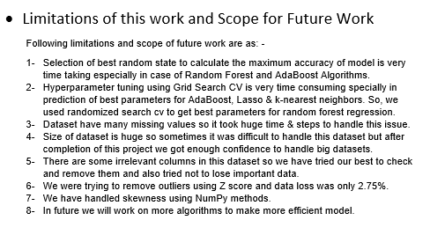
Conclusion 2
Limitations of this work and Scope for Future Work:-
Following limitations and scope of future work are as: -
Selection of best random state to calculate the maximum accuracy of model is very time taking especially in case of Random Forest and AdaBoost Algorithms.
Hyperparameter tuning using Grid Search CV is very time consuming specially in prediction of best parameters for AdaBoost, Lasso & k-nearest neighbors. So, we used randomizd search cv to get best parameters for random forest regression.
Dataset have many missing values so it took huge time & steps to handle this issue.
Size of dataset is huge so sometimes it was difficult to handle this dataset but after completion of this project we got enough confidence to handle big datasets.
There are some irrelevant columns in this dataset so we have tried our best to check and remove them and also tried not to lose important data.
We were trying to remove outliers using Z score but data loss was nearly 60.86%.so, we eliminated this process. In future we will try to use more statistical features.
We have handled skewness using NumPy methods and also performed PCA.
In future we will work on more algorithms to make more efficient model.

Slide 36

Thank You

